Slide 1

Using Big Data To Solve
Economic and Social Problems
Professor Raj Chetty
Head Section Leader Rebecca Toseland
Photo Credit: Florida Atlantic University

Slide 2
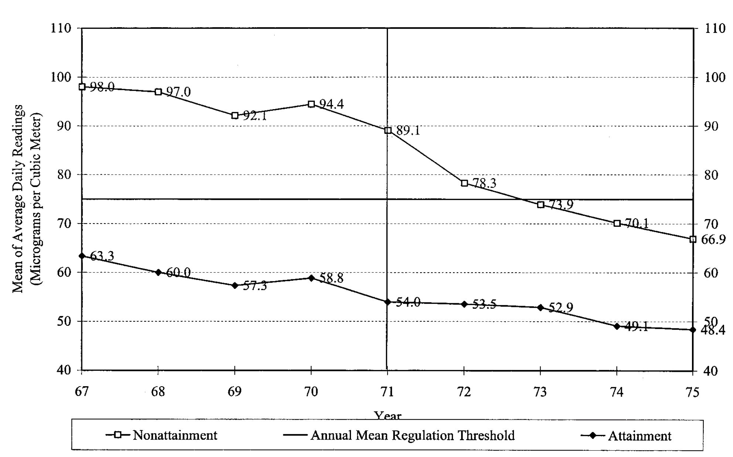
Impact of Clean Air Act on Air Pollution (Total Suspended Particulates)
Treatment, Before
Treatment, After
Control, Before
Control, After
Diff in Diff Estimate = (TA – TB) – (CA – CB)
Source: Chay and Greenstone 2005

Slide 3
Difference-in-Differences Quasi-Experimental Methodology
Diff-in-diff avoids biases that can arise from comparing different types of places or simply examining changes over time in a single place
Key identification assumption to make diff-in-diff as good as an experiment: parallel trends
  Absent the policy reform, outcomes would have changed similarly across the two types of areas
  Does not necessarily have to hold, but can be evaluated by examining data before the policy change

Slide 4
Impact of Clean Air Act on Air Pollution (Total Suspended Particulates)
Treatment, Before
Treatment, After
Parallel Trends Before Policy Change
Control, Before
Control, After
Diff in Diff Estimate = (TA – TB) – (CA – CB)
Source: Chay and Greenstone 2005

Slide 5
Effects of Pollution on Economic Outcomes
Isen et al. examine economic outcomes at age 30 vs. year of birth using this approach
Plot difference between outcomes in treated and control areas vs. birth cohort

Slide 6
Impact of Clean Air Act on Children’s Economic Outcomes at Ages 29-31

Slide 7
Impacts of Air Pollution: Summary
Reduction in pollution in non-attainment counties increased children’s earnings by about 1%
Implies that total gain in earnings was about $6.5 billion per birth cohort
Excludes other potential gains that may have accrued to society, but shows that benefits were quite substantial even purely in terms of earnings

Slide 8
Discounting Future Costs
Studies discussed thus far examine costs of environmental damage in a single year
  Ex: loss of GDP of 23% in 2100 due to climate change or $6.5 billion cost of greater air pollution for kids born each year
Final step in calculating social costs of environmental damage: add up this sequence of costs to generate a single current value
Critical question in this step: how much is money tomorrow worth today?
  If we don’t care about future generations, then costs are not large
  If we care equally about all generations, costs can be infinite

Slide 9
Estimating Long-Run Discount Rates
Challenge: how can we estimate how people value cash flows over a period of hundreds of years using real-world data?
Giglio, Maggiori, and Stroebel (2015) develop an innovative approach
Use data on all residential properly sales in the U.K. and Singapore in 2000s
Compare how much people pay for two different types of housing contracts
  Freeholds: perpetual ownership (like in the U.S.)
  Leasehold: ownership for a fixed period (e.g., 100 years or 1000 years)

Slide 10
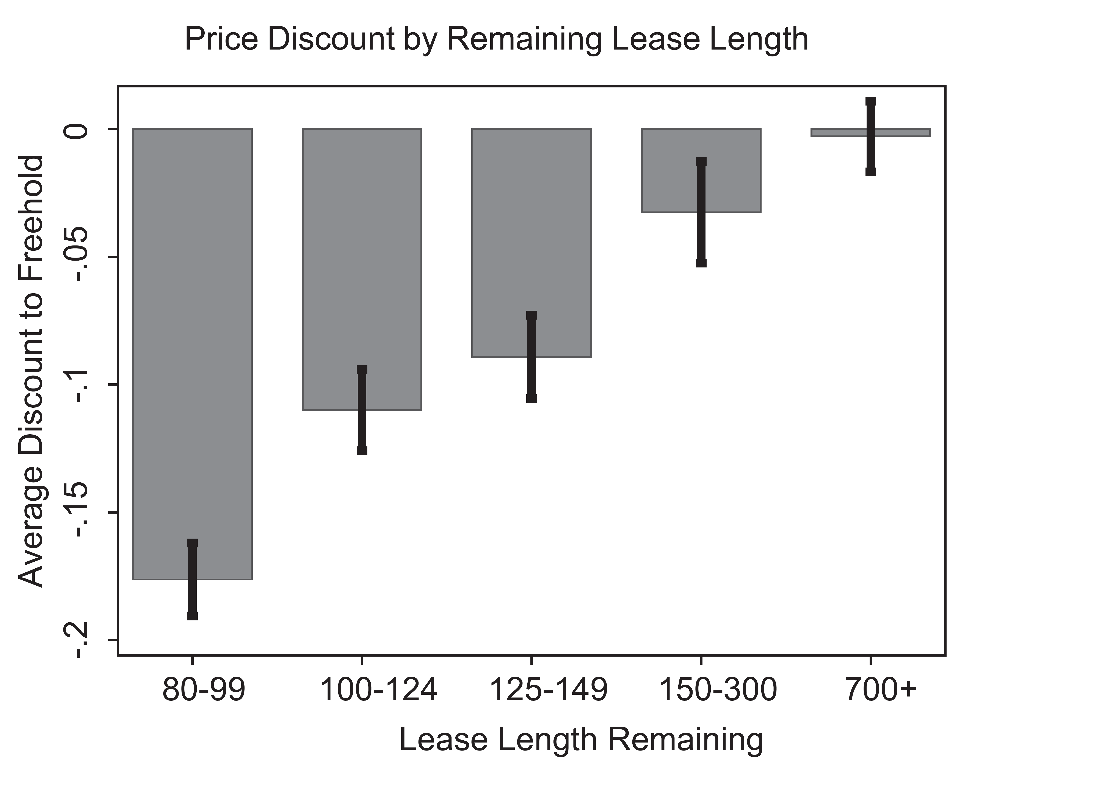
People pay 12% less for a house that they will own for 100 years relative to a house they will own forever

Slide 11
Estimating Long-Run Discount Rates
Price discount even for 100 yr+ leaseholds shows that they place substantial value on money then will have more than 100 years from now
Implied annual discount rate is 2.6%, i.e. $1,000 a year from now is worth $974 today

Slide 12
Summary: Social Cost of Carbon
Putting together all of these estimates, what is the social cost of carbon?
Obama Interagency Working Group on Social Cost of Carbon was tasked with answering this question
Compiled data on estimated impacts of carbon emissions
Applied a discount rate of 3% to future costs
→ Social cost of carbon set at $40 per ton of CO₂ emitted
  This number is now used in numerous policy decisions, ranging from fuel-economy rules for cars to regulations on power plants

Slide 13
Summary: Social Cost of Carbon
But this social cost estimate is not set in stone and is highly debated
Trump administration suggests using a 7% discount rate instead
  Yields a social cost of carbon of $5 per ton [Greenstone NYT 2016]
Would dramatically change the set of policies that the government will pursue

Slide 14
Policies to Mitigate Climate Change

Slide 15
How Can We Mitigate Climate Change and Reduce Pollution?
Given estimates of the costs of climate change, we can agree on targets in terms of reducing carbon emissions or air pollution
What policies can we use to change human behavior to achieve these social goals?
Most common policy tool: corrective (“Pigouvian”) taxes that increase private costs of consumption

Slide 16
Effects of Gasoline Taxes
Taxes on gasoline are one potential way to reduce gas consumption and CO₂ emissions
First question: are gas tax changes passed through to consumers or do just they affect the profits of oil companies?
Doyle and Sampatharank (2008) study this question using state-level gas tax reforms and a difference-in-differences design
  Gas prices spiked above $2.00 in 2000
  IN suspended its gas tax on July 1 and reinstated it on Oct 30
  IL suspended its gas tax on July 1 and reinstated it on Dec 31

Slide 17
Summer 2000 Difference in Log Gas Prices
IL/IN vs. Neighboring States: MI, OH, MO, IA, WI

Slide 18
Fall 2000 Difference in Log Gas Prices
IL/IN vs. Neighboring States: MI, OH, IL

Slide 19
Winter 2000/2001 Difference in Log Gas Prices
IL vs. Neighboring States: MI, IA, WI, IN

Slide 20
Effects of Gasoline Taxes on Gasoline Prices
Finding: 10 cent increase in gas tax → 7 cent increase in price paid by consumers
Implies that gas taxes could potentially reduce consumption of gas
Next question: how much less gas do people use when prices go up?

Slide 21
Effects of Gasoline Taxes on Gasoline Demand
Li et al. (2014) generalize this approach to estimate effects of state tax changes on demand for gas
Use data covering all 50 states and exploit changes in tax rates in all states from 1966-2008

Slide 22
Changes in State Gas Taxes from 1987-2008 (cents per gallon)

Slide 23
Effects of Gasoline Taxes on Gasoline Demand
To generalize diff-in-diff approach to 50 states and 44 years (more than 500 “experiments”), use a method called fixed effects regression
Relate differential changes in a state’s gas consumption (relative to avg. national change in a given year) to differential change in its tax rate
  Regress Δg_{sy} – Δg_{y} on Δtax_{sy} – Δtax_{y}
Resulting coefficient represents causal effect of tax change assuming that trends would be parallel across states absent tax changes

Slide 25
Effects of Gasoline Taxes on Gasoline Demand
10 cent increase in gas tax → 1.7% reduction in gasoline consumption
Transportation sector accounts for about 1/3 of carbon emissions → 10 cent increase in gas tax reduces carbon emissions by about 0.5%
[Davis et al. 2011]
For comparison, scientists predict that we need to cut CO2 emissions by about 50% to stop increase in global temperatures
Lesson: gas taxes make a difference, but need very large taxes to have a meaningful impact on climate change

Slide 26
Incentives to Purchase Hybrid Cars
Alternative approach: encourage people to buy more fuel-efficient cars
Federal and state governments offer incentives for purchase of hybrid cars
  Two types of incentives: sales tax rebates and income tax rebates
Gallagher and Muehlegger (2011) examine effects of these incentives on demand for hybrid cars exploiting state policy changes (diff-in-diff method)

Slide 27
Incentives to Purchase Hybrid Cars
Key result: sales tax rebates have 10 times as large an effect on hybrid car demand as income tax rebate of same amount
Why? Sales tax rebate offered at point of purchase and is very salient to consumer; income tax rebate is obtained months later and is less clear
Furthermore, changes in gas prices have small effects on purchase of hybrid cars
Results imply that way in which incentives are structured matters as much as dollar amounts
  Income tax rebates for hybrid cars cost the government money but do not effectively achieve policy goal of reducing emissions

Slide 28
Effect of Electricity Prices on Electricity Usage
Next, consider effects of prices on electricity consumption
Electricity is priced using tiered rates: price of an additional kilowatt is higher when you are already using a lot of electricity
Intended to discourage heavy usage without making electricity very expensive for the poor
Does tiered pricing work?

Slide 29
Analyzing Impacts of Tiered Price Schedules
Impacts of tiered price schedules can be analyzed by examining distribution of outcome variable
At points where prices change, we expect “bunching” in the distribution if people are responding [Saez 2010]
Simplest example: progressive income tax schedule
  Tax rate changes discontinuously at certain thresholds, analogous to a tiered pricing plan
Ex: low-income households receive Earned Income Tax Credit, which provides subsidies for earning more up to certain cutoffs

Slide 30
2008 Federal Earned Income Tax Credit Amount for Single Parents
$5K
$4K
$3K
Earned Income Tax Credit
$2K
$1K
$0K
$0
$10K
$20K
$30K
$40K
Total Earnings (Real 2010 $)
One Child
Two or More Children

Slide 31
Income Distributions for Individuals with Children in 2008 Based on U.S. Tax Data
5%
4%
3%
Percent of Tax Filers
2%
1%
One Child
Two Children
0%
$0
$10K
$20K
$30K
$40K
Total Earnings (Real 2010 $)
Source: Chetty, Friedman, Saez (2013)

Slide 32
Effects of Tiered Prices on Electricity Usage
Ito (2014) studies impact of prices on electricity usage using household-level billing data from utility companies in Orange County, CA
Utility company that provides service depends upon where families live: Southern California Edison (SCE) vs. San Diego Gas and Electric (SDG&E)

Slide 33
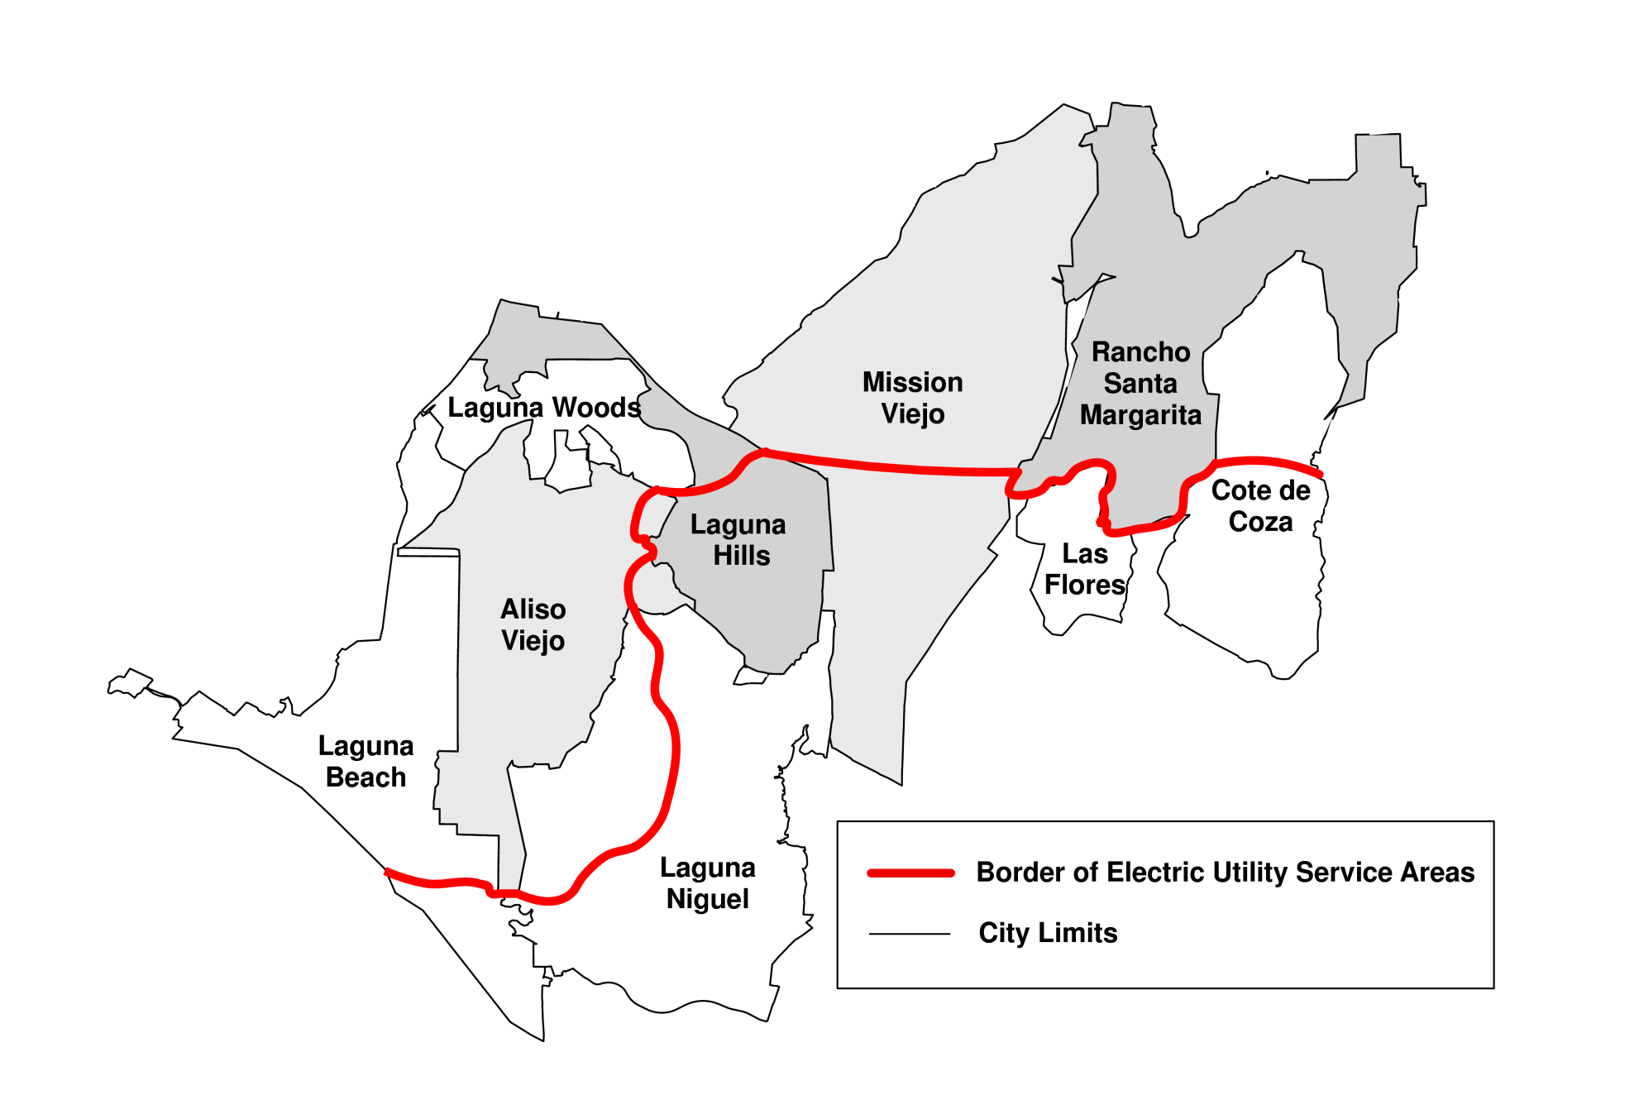
A Spatial Discontinuity in Electric Utility Service Areas in Orange County, California
SCE
SDG&E

Slide 34
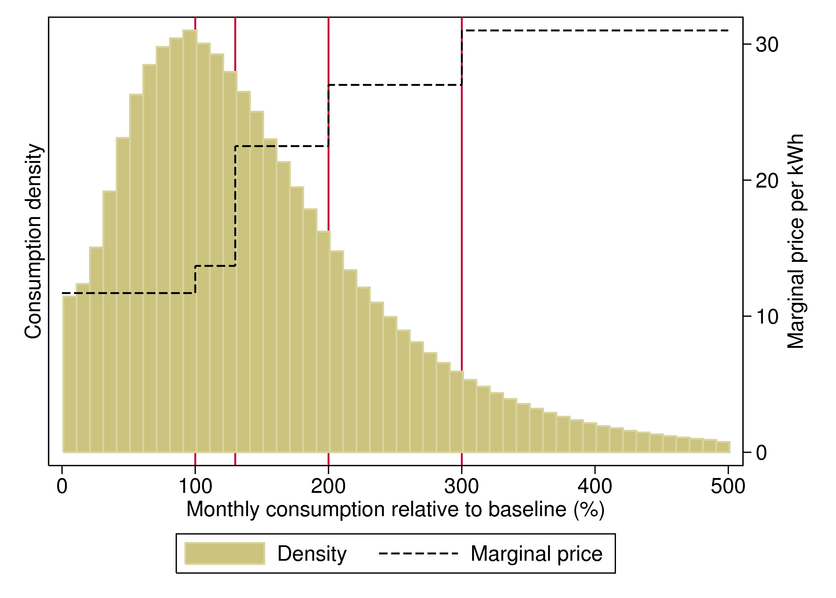
Prices and Distribution of Electricity Consumption for SCE Customers in 2007

Slide 35
Effects of Tiered Prices on Electricity Usage
No evidence of bunching at points where electricity prices jump → suggests that consumers are not responding to changes in tiered pricing
Two interpretations:
  Lack of salience: consumers are unaware of electricity price schedule
  Consumer demand for electricity is insensitive to price
To distinguish between these explanations, Ito uses a second strategy
In summer 2000, SDG&E raised average electricity prices, while SCE did not
  Uses a regression-discontinuity design to estimate effect of this change

Slide 36
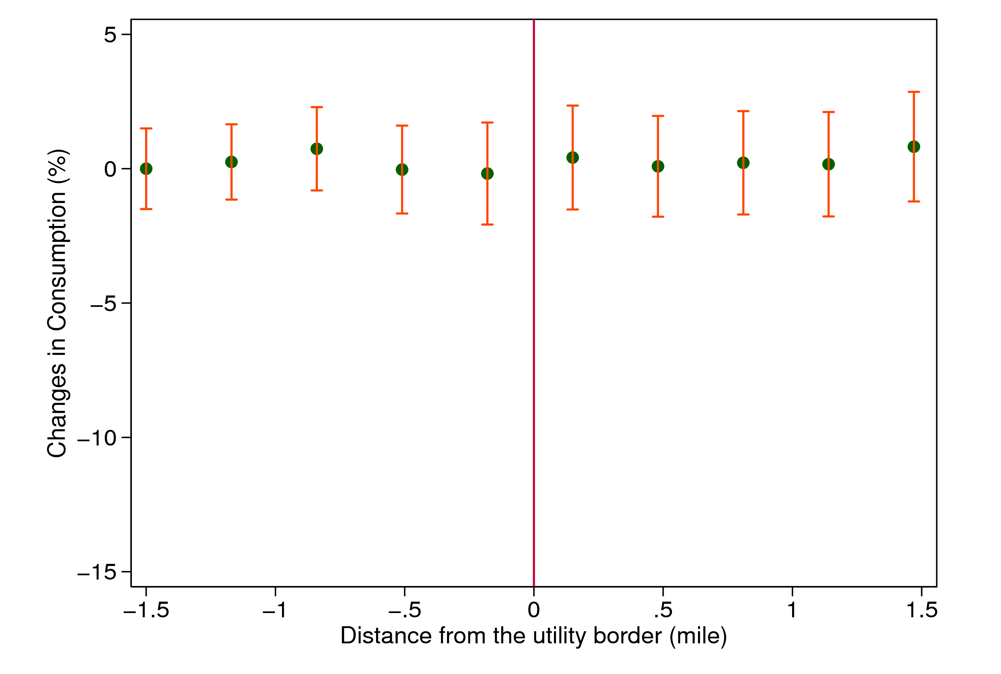
Changes in Consumption from July 1999 to July 2000,
by Distance from the Utility Border
SCE
SDG&E

Slide 37
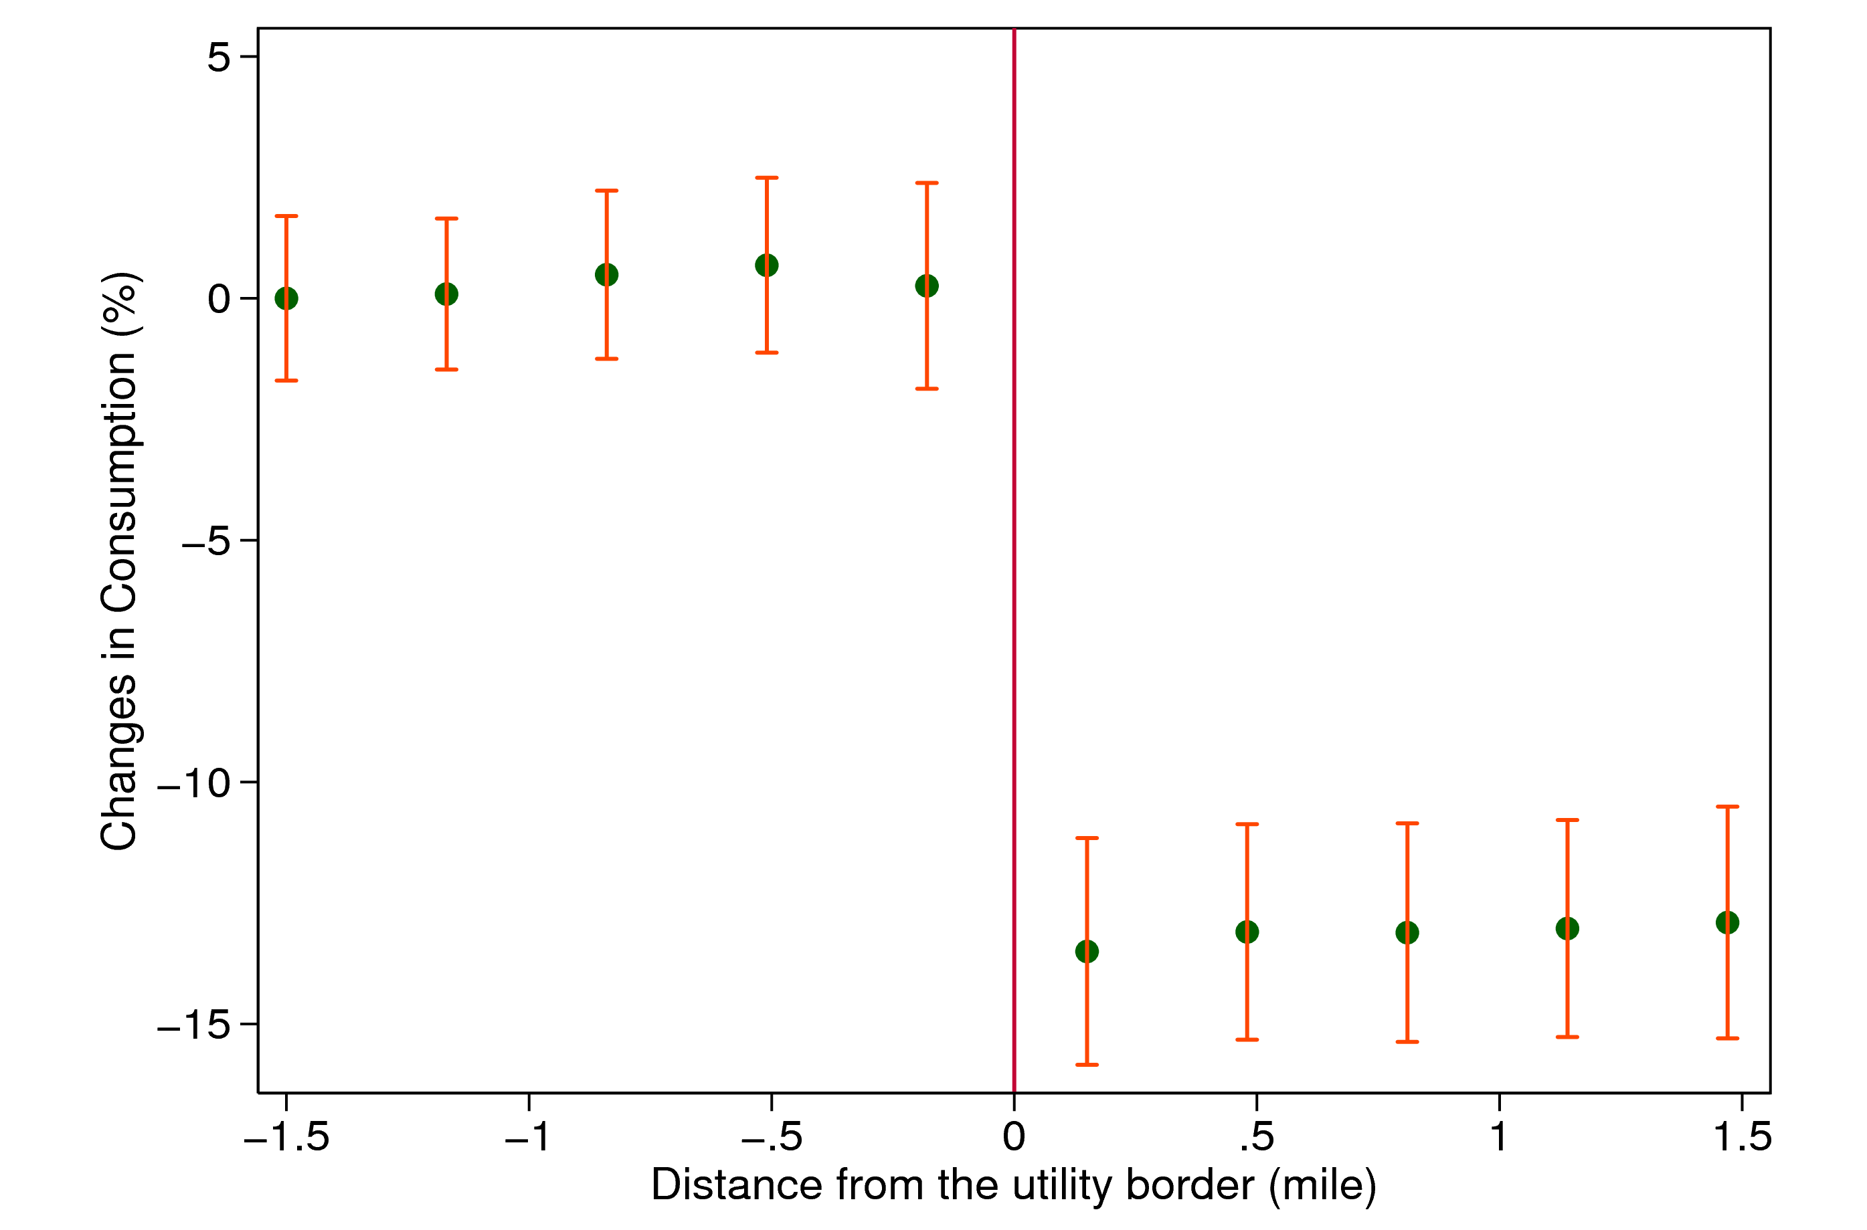
Changes in Consumption from August 1999 to August 2000,
by Distance from the Utility Border
SCE
SDG&E

Slide 38
Effects of Tiered Prices on Electricity Usage
Result: consumers are very sensitive to electricity prices when change is clearly visible, but do not respond to tiered pricing schedule
Implies that most consumers are not aware of the price they are paying for using additional electricity
Reinforces message that when designing corrective taxes, salience and structure of incentives matters as much as the dollars involved
  Traditional economics assumption that consumers are fully rational and perfectly informed about prices does not hold

Slide 39
How Can We Reduce Electricity Consumption More Effectively?
Two potential remedies to lack of effectiveness of tiered prices:
Make prices more salient to consumers using smart meters
  Pioneering technological work in this area done by O-Power
  Will discuss this approach further in Alex Laskey’s guest lecture next Tuesday
Use non-price tools motivated by results in social psychology
  Cialdini and collaborators (2007) demonstrate that social comparisons and injunctive social norms have significant effects on electricity use

Slide 41
Effects of Social Norm Treatments on Daily Electricity Consumption
Change in Electricity Usage (kWh/day)
Source: Schultz et al. (2007)

Slide 42
Magnitude of Social Norm Treatment
Social norms treatment reduces electricity usage by about 1 kilowatt-hour per day
  Equivalent to about a 2.5% reduction in electricity usage
  Analogous to turning off 10 hundred-watt lightbulbs for an hour a day
  Modest effect, but does not require charging consumers higher prices

